Slide 1
Nutritional Anemia
DR Mansour ALQurashi

Slide 2
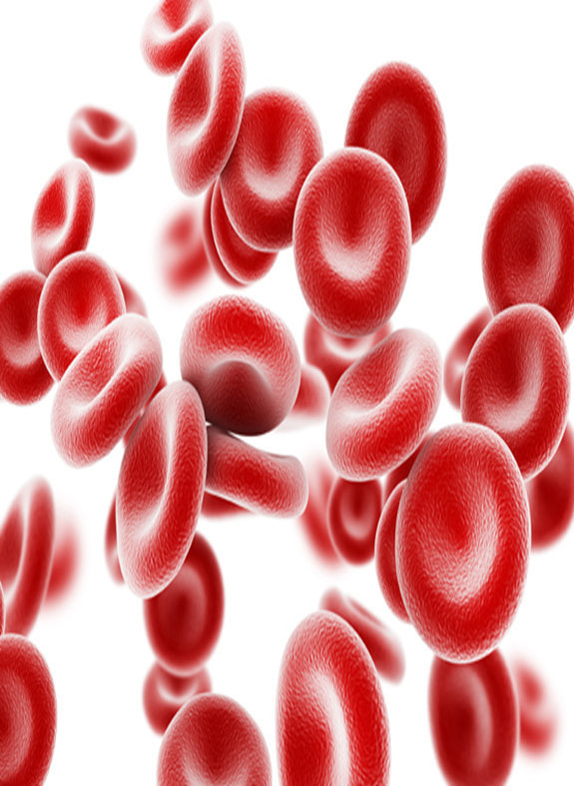
Anemia
Anemia is defined as reduction in the oxygen carrying capacity leading to tissue hypoxia and results in reduction in red cell volume or hemoglobin concentration and hematocrit below normal or two standard deviations below the mean for the normal for age and sex.

Slide 3
WHO/UNICEF/UNO (1997 morphological classification)
Morphological Classification | Microcytic Hypochromic anemia | Normocytic Normochromic anemia | Macrocytic anemia
MCV | < 80 fl | 80–94 fl | > 94 fl
MCH | < 29pg | 29–34 pg | N
MCHC | < 30% | 30–36% | N

Slide 4
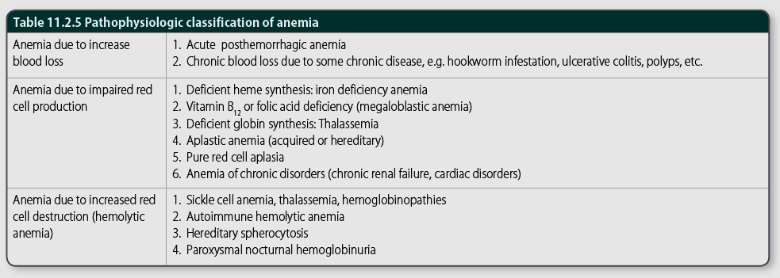
Pathophysiologic classification of anemia

Slide 6
Approach to a case of Anemia
History
This should include enquiry about:
• The presence of chronic diseases, (especially renal), or prematurity.
• Gastrointestinal symptoms.
• Dietary history: adequate iron intake
• Family history: relatives with inherited disorders such as sickle cell disease, thalassaemia or hereditary spherocytosis.
• Place of birth: sickle cell screening has been part of the Guthrie test

Slide 7
Examination
Causes of anemia are very age-dependent and inherited anemias show a racial preponderance:
• Afro-Caribbean ancestry: sickle cell disease.
• Mediterranean and Asian ancestry: Thalassaemia.
Associated signs
• Jaundice: suggests acute haemolysis.
• Petechiae or bruising: suggest marrow failure.
• Splenomegaly: suggests haemolysis, haemoglobinopathy or marrow failure.

Slide 8
Investigation
The most important initial investigation is a full blood count (FBC) to confirm reduced haemoglobin concentration and document red cell indices.
Additional valuable information from the FBC includes:
• Reticulocytes: an increase suggests haemolytic anaemia; a decrease suggests marrow aplasia.
• Pancytopenia: a reduction in all cell types suggests marrow failure or hypersplenism.
• A peripheral blood film can also reveal abnormal cells (blasts) commonly seen in leukaemias.

Slide 9
Investigation … con
Depending on the initial results, further investigations might include:
• Iron studies: serum iron, ferritin and total iron binding capacity.
• Direct antiglobulin test (DAT or Coombs’ test): this is positive in immune- mediated haemolysis.
• Red cell folate, vitamin B12.
• Haemoglobin electrophoresis.
• Red cell enzymes: glucose-6-phosphate dehydrogenase (G6PD), pyruvate kinase.
• Bone marrow aspiration.

Slide 10
Functions of iron
Formulation of hemoglobin
Formulation of cytochrome myoglobin
Binding O₂ to RBC and transport
Regulation of Body temperature
Muscle activity
Catacholamine metabolism
Immune system – ↓ T cell ↓antibodies
Brain Development & function
Depressed thyroid function

Slide 11
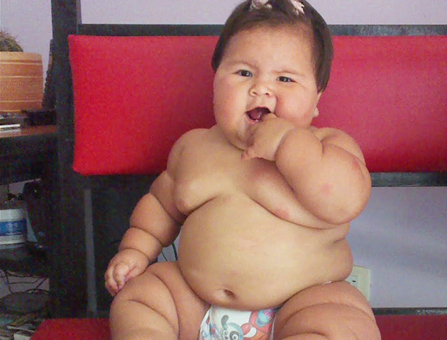
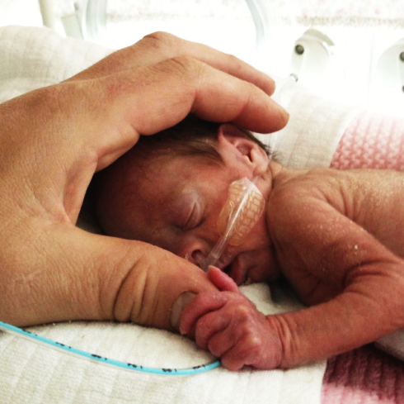

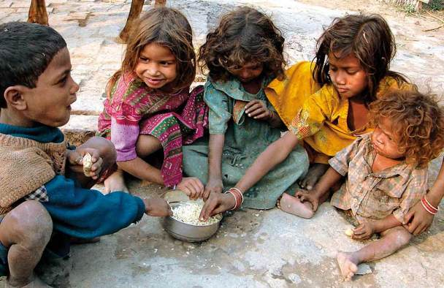
Risk factors of IDA
Low socioeconomic status
Prematurity and low birth weight
Excessive milk intake
Early introduction of cow’s milk
Prolonged bottle feeding
Prolonged exclusive breast feeding
Overweight and obesity

Slide 12
Causes of Iron Deficiency

Slide 13
IDA Screening
For all children, perform laboratory screening at 9 to 12 months of age.
For children fed an iron-fortified formula,delay to 15 to 18 m of age..
For children with risk factors for iron deficiency (eg, history of prematurity or dietary risk factors such as excessive milk intake , Test when risk is identified (at birth and 4 months), Test again, eg, at 15 to 18 months of age
children with special health needs (chronic infection, inflammatory disorders, chronic gastrointestinal dysfunction, history of intestinal surgery, or restricted diets),test at 9 months , Repeat laboratory screening at 15 to 18 months of age, and again in early childhood, eg, between two to five years of age .
For breastfed infants, iron supplement between 4-6 m of age for term infants (two weeks of age for premature infants). iron supplements continued until the infant is taking sufficient quantities of iron-rich complementary foods, such as infant cereal.
For all children, dietary measures include:
-Introduce iron-rich complementary foods at four to six months of age
-Avoid unmodified (nonformula) cow's milk until age 12 months; after 12 months
of age, limit milk intake to no more than 600 mL daily.(cow's milk protein
-induced colitis).

Slide 14
Screening
Screening for high risk , or mentioned diseases such as prematurity at birth and 4 months
The AAP suggests universal laboratory screening for IDA at approximately 9 to 12 months of age and repeated screens for children with risk factors.
For children at high risk, screen once a year from ages 2 to 5 years.

Slide 15
Developmental Stages of Iron Deficiency Anemia
Low ferritin Absent bone marrow iron | Pre-latent iron deficiency (exhaustion of tissue reserve of iron asymptomatic ) | Stage 1
Low transferrin saturation Low serum iron Raised serum transferrin Normal hemoglobin | Latent iron deficiency (deficit of iron in the tissue and the decrease of its reservoir transport) | Stage 2
Low hemoglobin Low hematocrit | Frank Iron deficiency anemia | Stage 3

